Slide 1
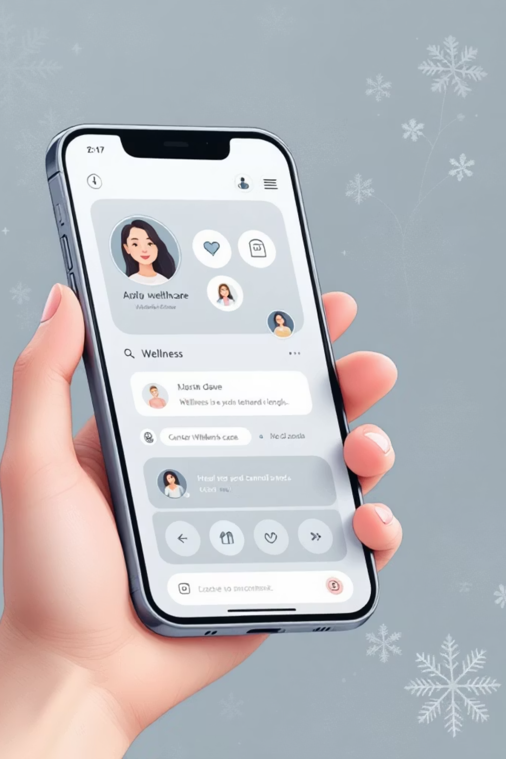
WellBot – AI Powered Wellness Chatbot Platform
Intelligent Healthcare Assistant with Hybrid AI and Real-Time Analytics
Avinash Gouda | Healthcare Technology Course | 2024

Slide 2
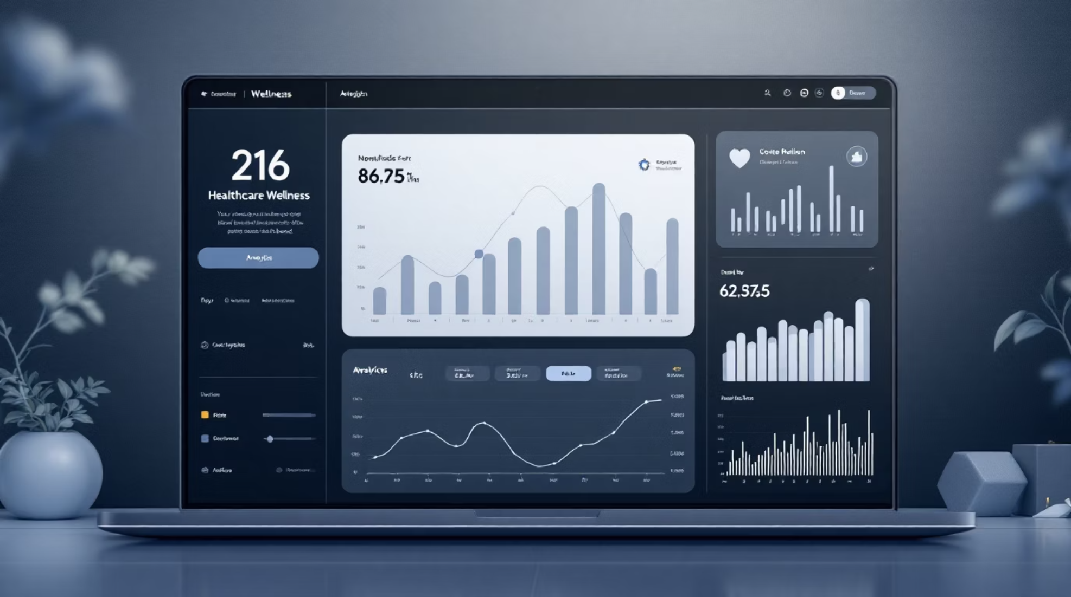
Project Overview
What is WellBot?
An AI-powered wellness assistant that combines intelligent chatbot technology with prescription analysis and comprehensive health monitoring. WellBot serves as a centralized platform for health guidance, symptom assessment, and personalized wellness tracking.
Key Features
AI wellness chatbot with multi-model support
Prescription image analysis and interpretation
Comprehensive symptom checker
Nutrition and wellness guidance
Real-time user dashboard with activity tracking
Admin monitoring and analytics system

Slide 3


Problem Statement
Prescription Confusion
Patients struggle to understand complex medical prescriptions and dosage instructions
Limited Access
No 24/7 access to quick, reliable health advice when medical professionals are unavailable
No Centralization
Lack of unified AI wellness platform integrating chat, tracking, and analytics
No Personalization
Absence of continuous, personalized health tracking and wellness recommendations

Slide 4
Proposed Solution: WellBot
AI Wellness Chatbot
Prescription Analysis
Intelligent conversational interface powered by multiple AI models for accurate health guidance and symptom assessment
Image recognition technology that reads and interprets prescription details, providing clear dosage instructions
Symptom Checker
Nutrition Guidance
Guided assessment tool that evaluates symptoms and provides preliminary health insights with appropriate recommendations
Personalized dietary recommendations based on user health profile and wellness goals
Admin Monitoring
Health Tracking
Comprehensive analytics dashboard for administrators to track system performance and user engagement
Real-time wellness monitoring including mood tracking, nutrition logging, and activity measurement

Slide 5





System Architecture
WellBot employs a hybrid AI architecture that routes queries through multiple language models to optimize response quality and cost efficiency.
User Interface
Responsive frontend dashboard for patients and administrators
Flask Backend API
RESTful interface handling requests and data processing
AI Model Router
Intelligent routing system selecting optimal AI engine
Multi-Model AI
Groq, Gemini, Ollama, and OpenAI integration
MongoDB Storage
Secure document database for user data and analytics

Slide 6
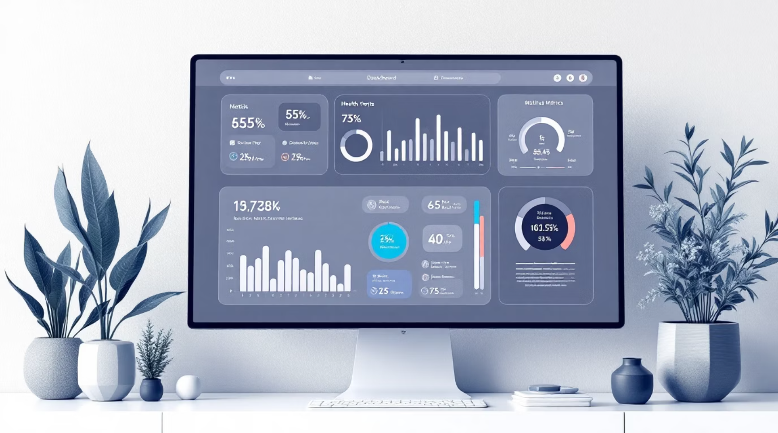
User Dashboard Features
Core Dashboard Components
Mood Tracking
Daily emotional wellness logging with trend visualization
Nutrition Guide
Meal logging and dietary recommendations based on health profile
AI Chatbot
Instant access to health guidance and symptom assessment
Symptom Checker
Step-by-step health assessment tool with severity indicators
Profile Management
Centralized control of health data and preferences

Slide 7

New Update 1: Multi-Language System 🌍
Language Selection
Supported Languages
Users can dynamically change the interface language with a single click, making healthcare accessible to diverse populations
English (default)
Hindi
Kannada
Spanish
Global Accessibility
Breaking language barriers to provide healthcare assistance to users worldwide, regardless of their primary language

Slide 8
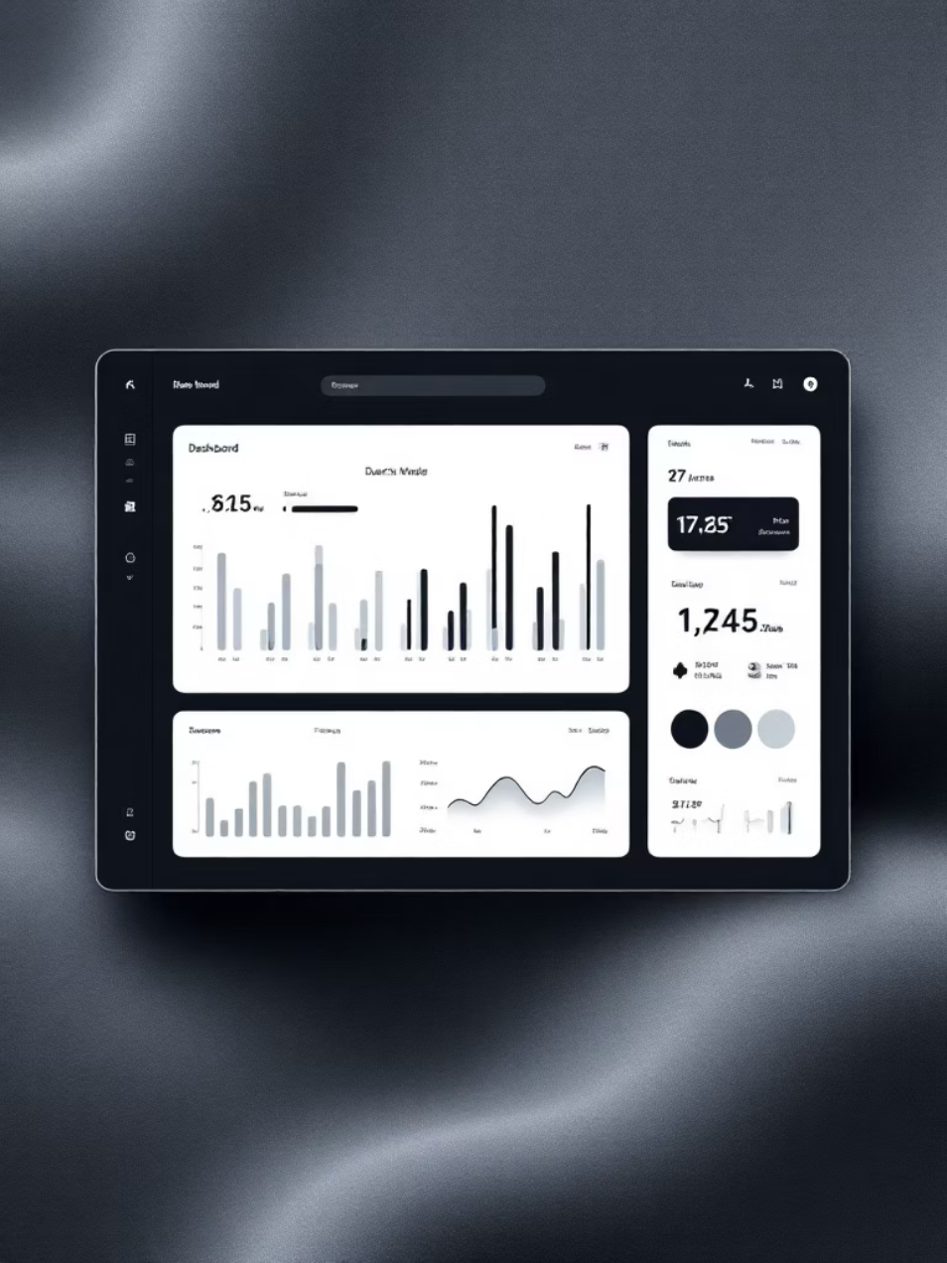

New Update 2: Theme System 🌙
Dark Theme
Light Theme
Classic light interface optimized for daytime use with reduced eye strain
Sleek dark interface perfect for nighttime use, reducing blue light exposure
Users can switch between themes instantly, and the entire website background, components, and text colors update in real-time to match the selected theme.

Slide 9
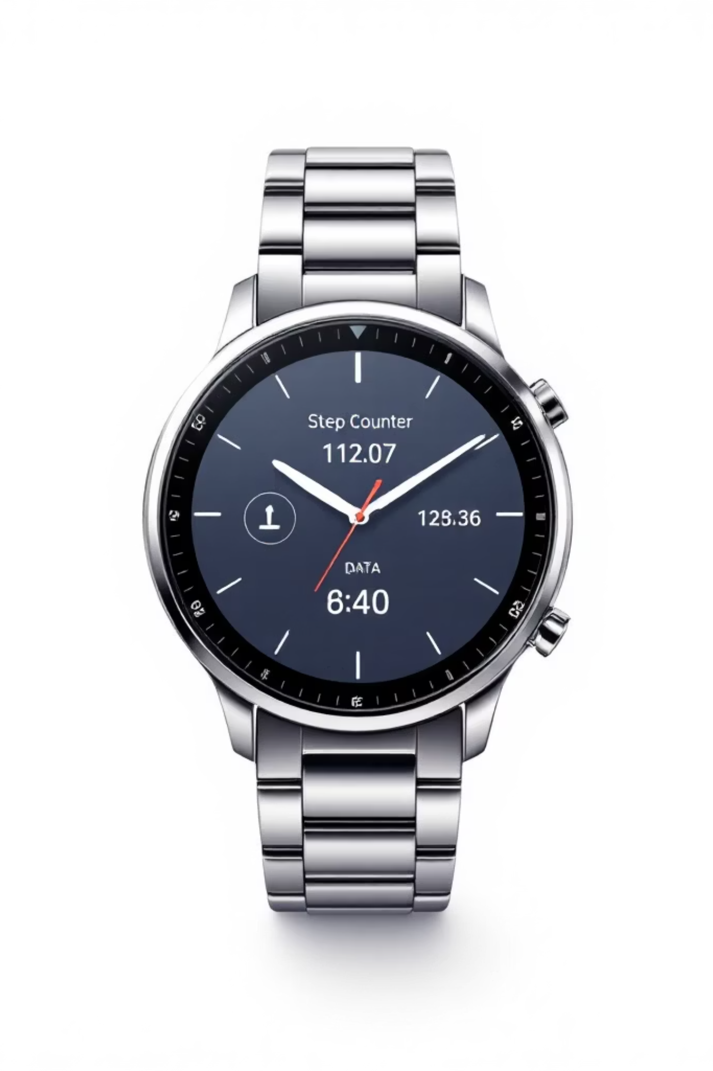
New Updates: Real-Time Features
👣 Footprint Counter
Real-time step tracking that updates throughout the day, encouraging users to maintain an active lifestyle with instant feedback on their physical activity
🤖 Admin Chatbot
Floating chatbot icon on the admin dashboard provides instant access to AI testing, allowing administrators to quickly verify chatbot responses and system functionality

Slide 10


Admin Dashboard & Conclusion
Admin Capabilities
User Management
View and manage all registered users
Chat Log Monitoring
Review conversation history and interactions
AI Usage Analytics
Track model performance and query patterns
Issue Reporting
WellBot's Impact
View and address reported problems
WellBot provides AI-powered healthcare assistance through secure, scalable architecture with real-time health monitoring, multi-language accessibility, and intelligent admin analytics.
System Statistics
WellBot aims to make healthcare assistance faster, smarter, and accessible to everyone.
Monitor overall platform health and metrics

